Slide 1
Sports Analytics Hackathon
Team Number

Slide 2
Report Structure
Abstract
Data and Variables
Method and Approach
Visualization
Conclusion and Summary

Slide 3
Variables_Predictor
Variable | Notes
X1 | Difference of Additive Scores 3min B4 Time Out
X2 | Difference of Cumulative Scores 3min B4 Time Out
X3 | Time of Time Out

Slide 4
Variables_Response
Variable | Notes
Y1 | Difference of Additive Scores 3min After Time Out
Y2 | Difference of Cumulative Scores 3min After Time Out
Y3 | Change of Scores Within Quarter

Slide 5
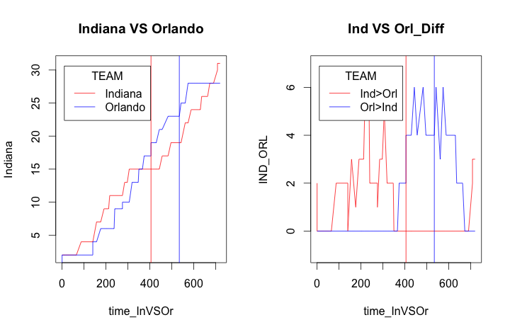
Indiana VS Orlando_1st Quater
Notes:
These two plots are equivalent:
Around 300~400 sec of the first quarter, Not only did Indiana fail to score but also it got surpassed by Orlando.
That is why Indiana requested a Time Out, hence, the red vertical line.
The blue line also make sense, Orlando realized that Indiana is about to overtake then should they not take any precautions.
But, at the end of the first quarter, it only seems inevitable that Indiana takes back the lead in the very last minute.

Slide 6
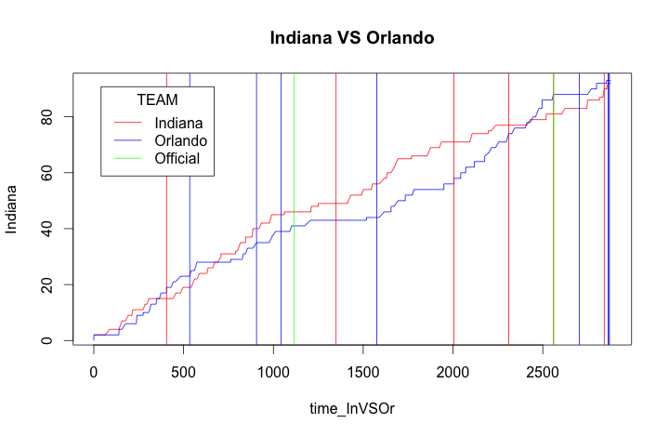
Indiana VS Orlando

Slide 7
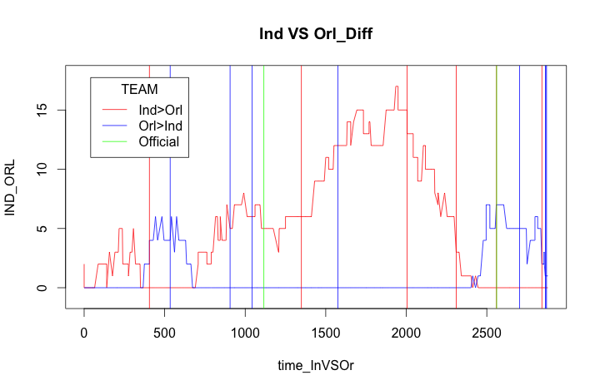
Indiana VS Orlando

Slide 8




